Slide 1
UAVSAR LITE
2022 CAPSTONE PROJECT
Sprint 5

Slide 2
Sprint OBECTIVE
The goal of this sprint is to
Derive the equation for a linear FM Sweep
Build a linear FM sweep in Matlab
Build a matched filter in Matlab

Slide 3


Linear fm chirp
The IWR6843AOP uses a Frequency Modulated Continuous Wave pulse. Therefore it is important to understand what a linear FM chirp is.
In a linear-frequency chirp or simply linear chirp, the instantaneous frequency f(t) varies exactly linearly with time. It is a signal in which the frequency increases up or down with time. It is commonly used in radar.
Mathematically it can be described as a complex exponential with quadratic phase:
Complex exponential at baseband
Where

Slide 4
What is instantaneous frequency?
The instantaneous frequency of a nonstationary signal is a time-varying parameter that relates to the average of the frequencies present in the signal as it evolves.
Instantaneous frequency provides an approximation of the frequencies in the signal at a given point in time. This is important to a linear chirp because the FM pulses used in the radar system can be represented and analyzed as a time varying function.

Slide 5




Linear fm chirp
Mathematical description:
We start with a sinusoid(cosine here) signal with amplitude A, and angular frequency w0 and initial phase fie.
This can be written as the instantaneous phase
Where is the instantaneous phase of the sinusoid and it is linear in time. The time derivative of instantaneous phase is equal to the angular frequency of the sinusoid – which in this case is a constant in the above equation.

Slide 6



Linear fm chirp
Instead of having the phase linear in time, let’s change the phase to quadratic form and thus non-linear.
for some constant
Therefore, the equation for chirp signal takes the following form,
The first derivative of the phase, which is the instantaneous angular frequency becomes a function of time, which is given by
The time-varying frequency in Hz is given by

Slide 7


Linear fm chirp
In the above equation, the frequency is no longer a constant, rather it is of time-varying nature with initial frequency given by . Thus, from the above equation, given a time duration T, the rate of change of frequency is given by
Where, is the starting frequency of the sweep, and is the frequency at the end of the duration T.
Substituting (7) & (8) in (6)

Slide 8
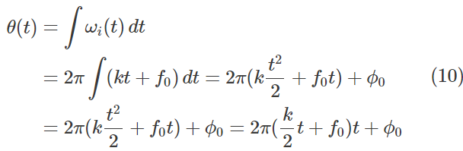


Linear fm chirp
From (6) and (8) we can integrate the instantaneous angular frequency.
where is a constant which will act as the initial phase of the sweep.
Thus the modified equation for generating a chirp signal (from equations (5) and (10)) is given by
where the time-varying frequency function is given by

Slide 9
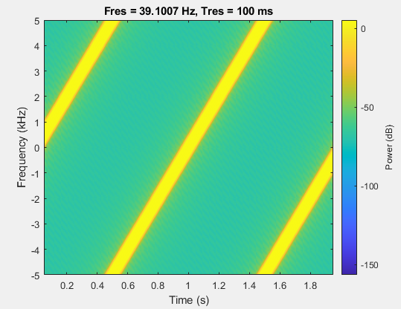
Spectrogram plot of a chirp complex signal
The chirp is sampled at 10 kHz for 2seconds. The instantaneous frequency is 0 at t = 0 and crosses 5 KHz at t = 0.5 seconds. The spectrogram plot shows the complex signal

Slide 10
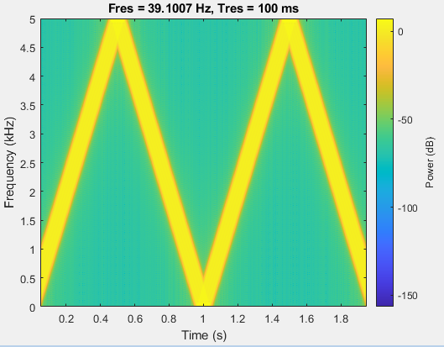
Spectrogram plot of a chirp real signal
The chirp is sampled at 10 kHz for 2seconds. The instantaneous frequency is 0 at t = 0 and crosses 5 KHz at t = 0.5 seconds. The spectrogram plot shows the real signal

Slide 11
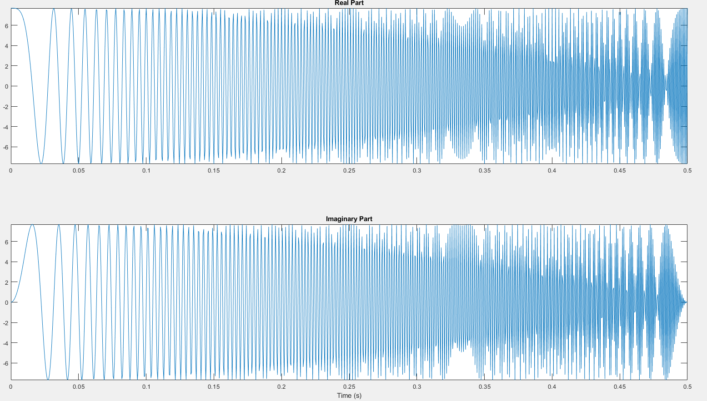
Real and imaginary time series
The chirp is sampled at 2 kHz for 1 second. Starts at 0 and stops at 1 KHz First .5 seconds of signal

Slide 12
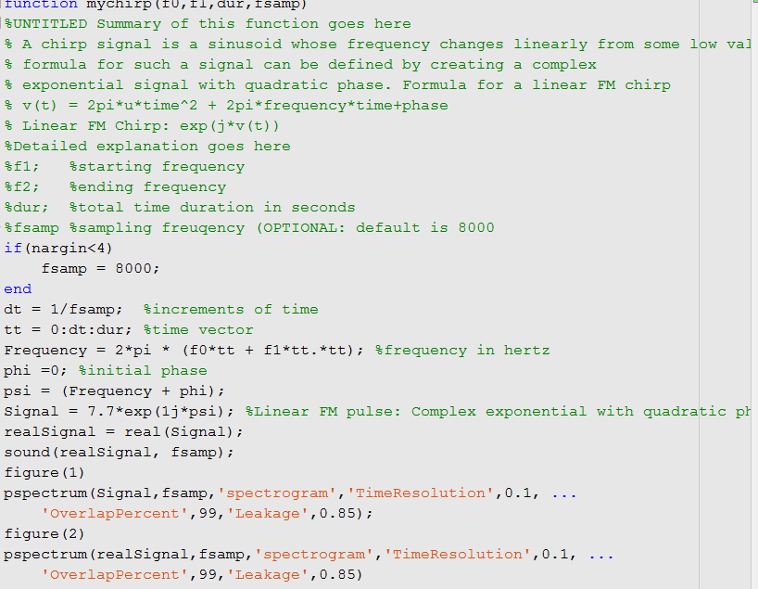
Matlab Linear chirp example

Slide 13
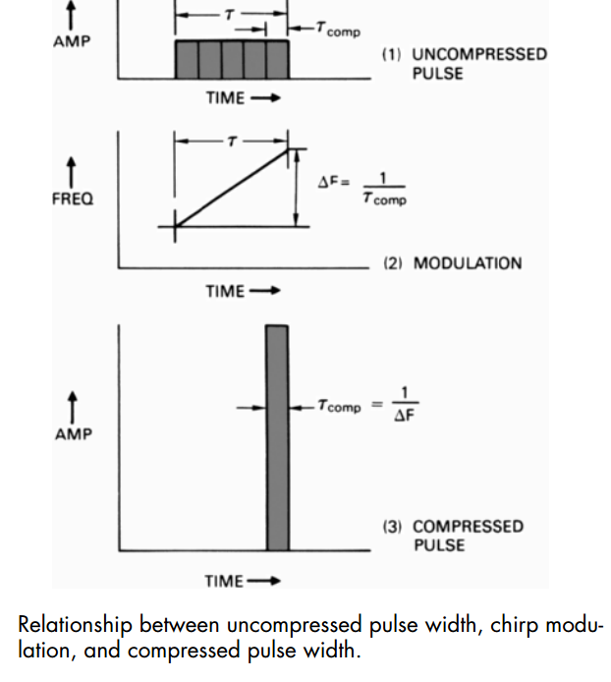
Importance to radar
Pulse compression is technique used in radar that allows a burst of pulses to be transmitted successively and then received and compressed as if 1 pulse was sent out.
Linear frequency modulation has the advantage of enabling very large compression ratios to be achieved. In addition, it is comparatively simple. No matter when a pulse is received or what its exact frequency is, it will pass through the filter equally well and with the same amount of compression.

Slide 14
Matched filter
What is a matched filter?
A filter that is obtained by correlating a known delayed signal, or template, with an unknown signal to detect the presence of the template in the unknown signal. This is equivalent to convolving the unknown signal with a conjugated time-reversed version of the template. The matched filter is the optimal linear filter for maximizing the signal-to-noise ratio (SNR) in the presence of additive stochastic noise.
Why match filters?
Match filters enable the usage of pulse compression by transforming a long duration frequency-coded pulse into a narrow pulse of greatly increased amplitude

Slide 15
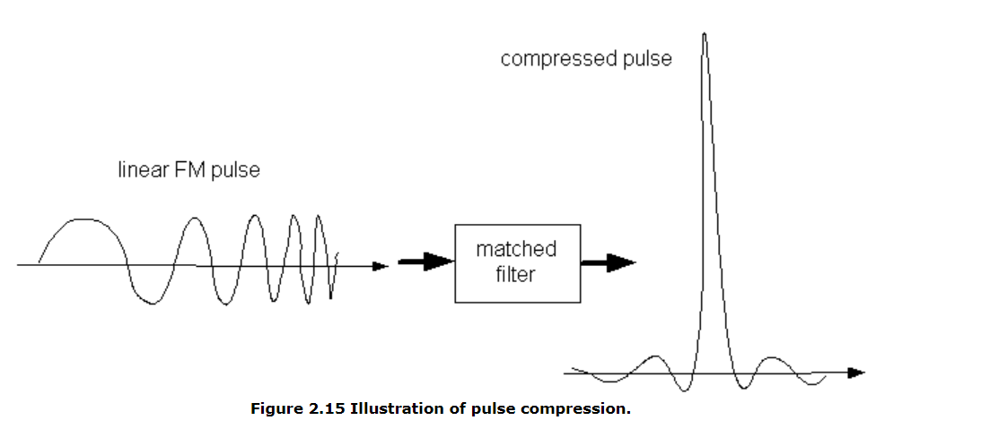
Matched filter

Slide 16
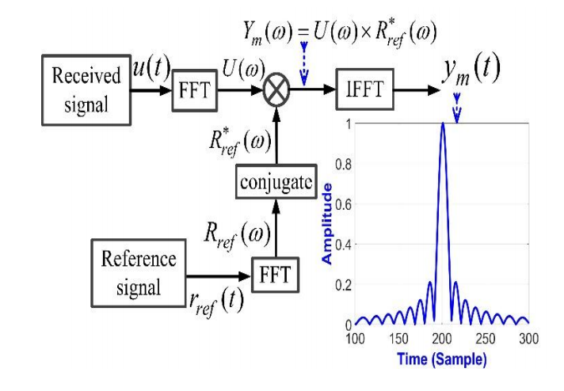
Matched filter

Slide 17
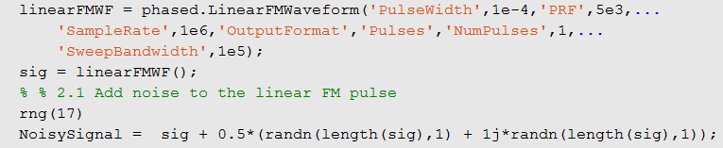
Matched filter matlab example
Create a matched filter for a linear FM waveform with a duration of 0.1 milliseconds, a sweep bandwidth of 100 kHz, and a pulse repetition frequency of 5 kHz with stochastic noise.
Signal:

Slide 18
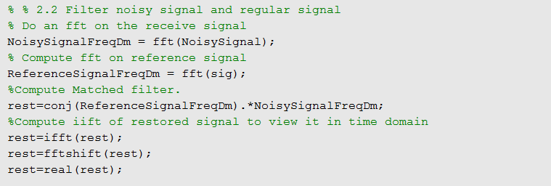
Matched filter matlab example
Matched filter:

Slide 19
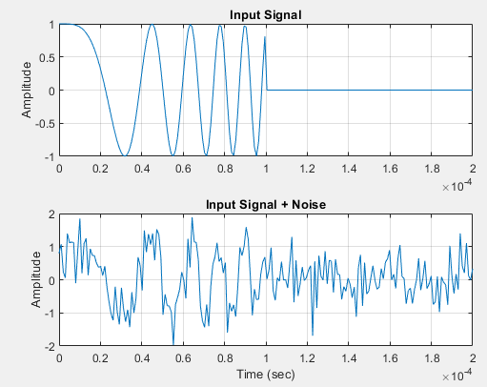
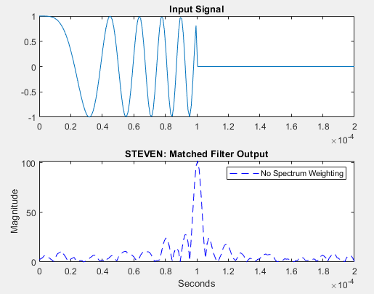
Matched filter matlab example

Slide 20
retrospective

